Slide 1
PIZZA SALES DASHBOARD
created by Annapoorna Choudi

Slide 2
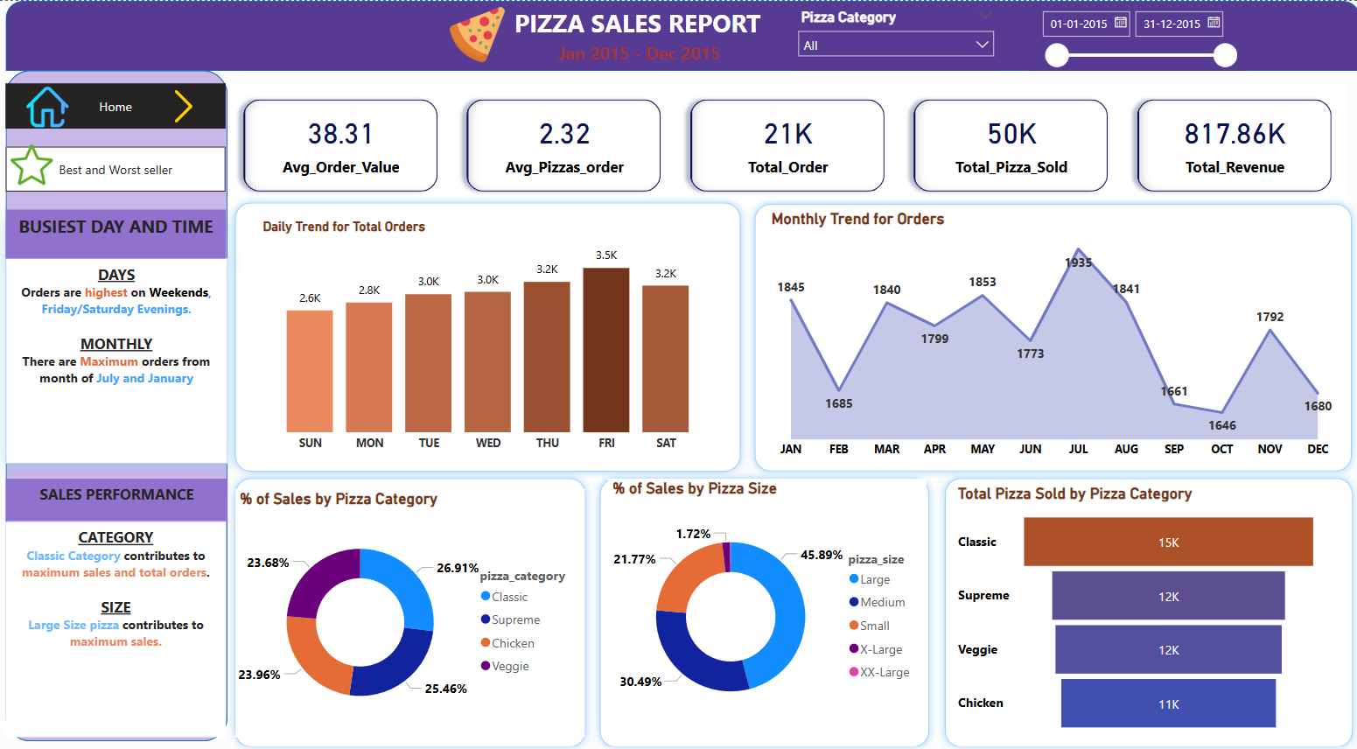

Slide 3
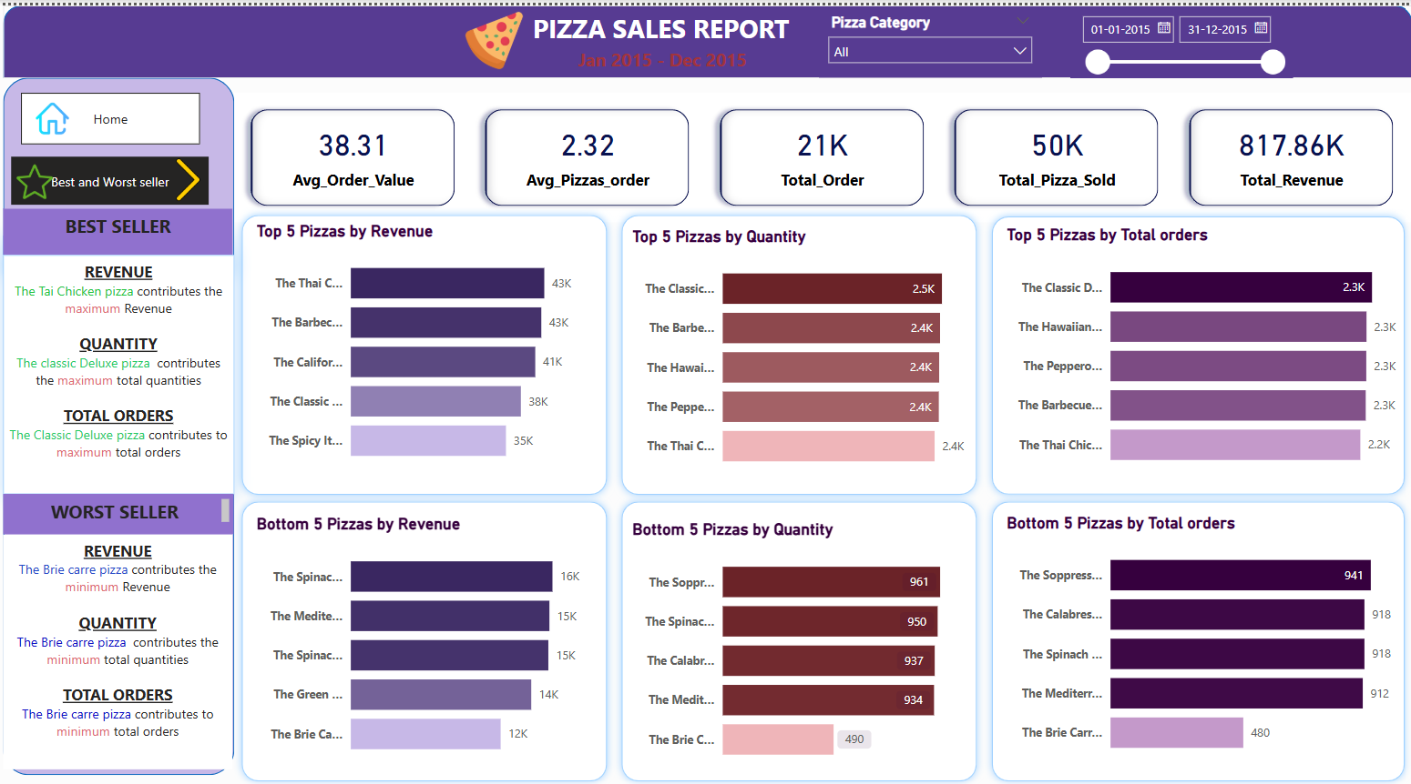

Slide 4
Data Verification: SQL Queries & Power BI Report
Power BI report insights cross-checked with SQL queries for accuracy
Visualization from Power BI

